Slide 1
Automatic brain tumor classification:
Automatic classification of the brain tumor type based on histological sections of the tumor using machine learning

Slide 2
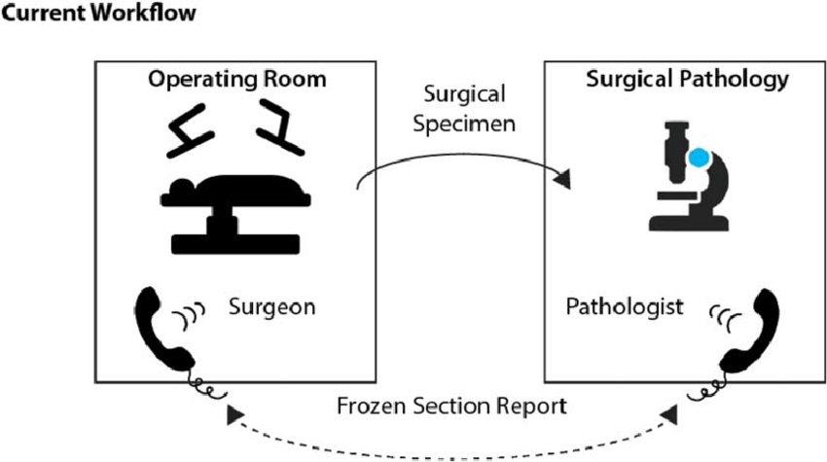
Background/Vision:

Slide 3
Background/Vision:

Slide 4
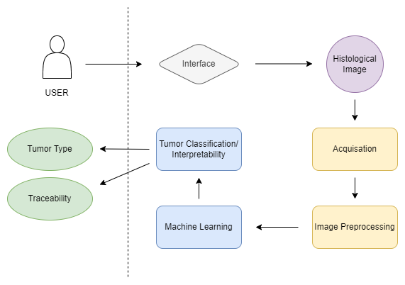
Idea:

Slide 5
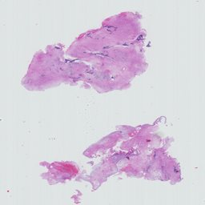
Preprocessing strategy:
The Digital Brain Tumour Atlas
Roetzer-Pejrimovsky et al.
3,115 slides scans of 126 brain tumour types (including 47 control tissue slides) amounting to 3.6TiB of data
uuid | pat_id | diagnosis | grade | subtype | secondary_diagnosis | control | age | sex | location | laterality | cellularity | tissue_area | recurrence | comment
a1965749-357f-11eb-801a-001a7dda7111 | 0 | Glioblastoma, IDH-wildtype | IV |  |  | 0 | 66 | male | [] |  | 3693.74249 | 24.09859384 | 0

Slide 6
Preprocessing strategy:
Data Loading: We begin by loading the annotation.csv file which contains clinical annotations for each patient. This includes patient demographics, tumor characteristics (type, grade, subtype), and other relevant clinical details. Note that label in the code corresponds to a patient's tumor type.
Data Downloading and Preprocessing: The histopathological images corresponding to each patient are hosted on the EBRAINS data proxy API. This notebook contains a script to download these .ndpi files. Given the irregular sizes of these images, we have implemented a mechanism to ensure that downloaded images have a minimum size (512x512, 1024x1024, 2048x2048 pixels) for consistency and ease of further processing.

Slide 7
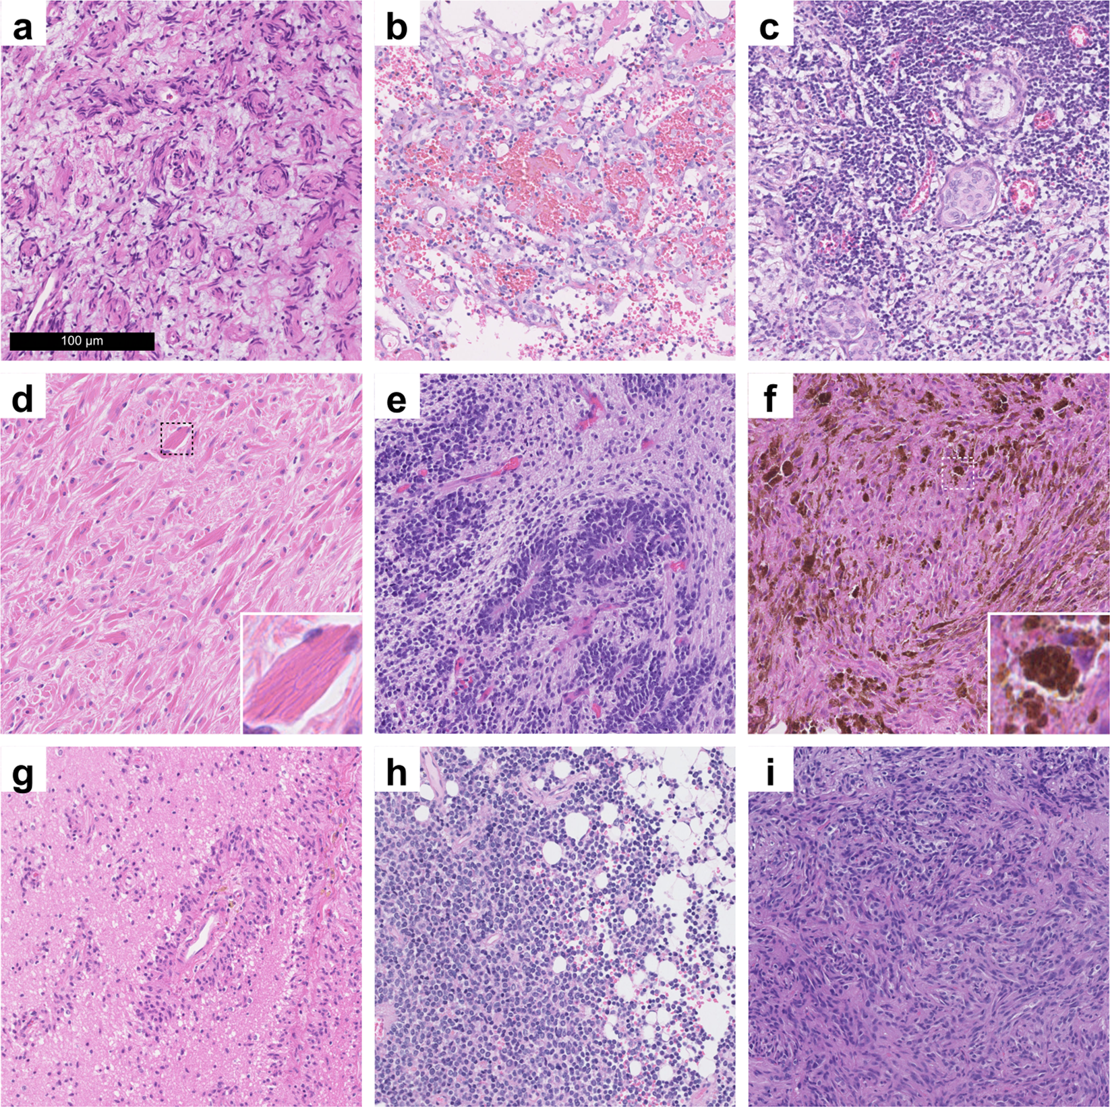
Task: Classification of the brain tumor type

Slide 8
Task: Classification of the brain tumor type
Perineurioma
Angiosarcoma
Lymphoplasmacyte-rich meningioma
Crystal-storing histiocytosis
Embryonal tumour with multilayered rosettes
Melanotic schwannoma
Angiocentric glioma.
Cerebellar liponeurocytoma
Pituicytoma

Slide 9
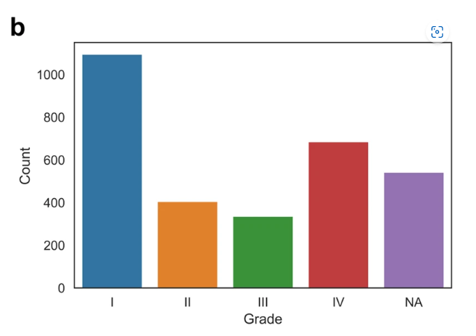
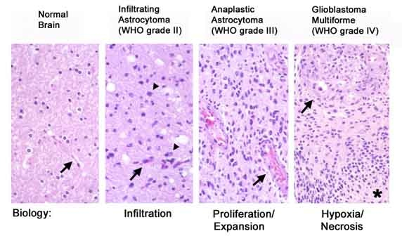
Task: Classification of the brain tumor grade

Slide 10
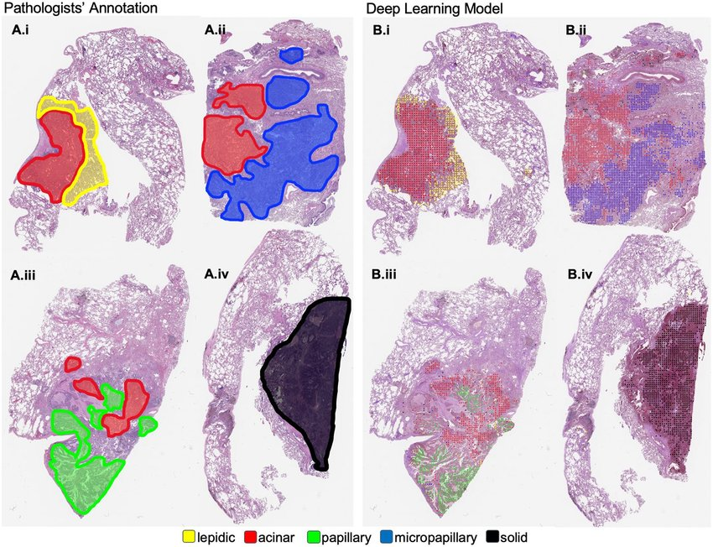
Task: Lighting up the Blackbox for Interpretability?

Slide 11
Application:
Website?
1.Uploading a histological image
2. Get classification and interpretable data (blackbox)
3. Visualization of the interpretable data
highlighting the tumor in the image?

Slide 12
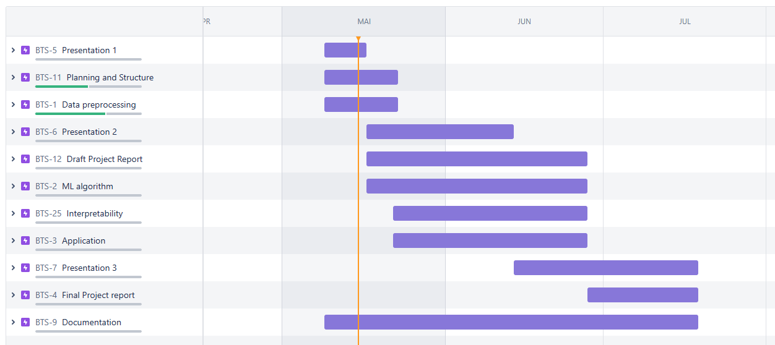
Plan: Roadmap

Slide 13
Current Questions:
Do we have access to hardware from the university?

